Slide 1
TEAM #13
Capstone Progress
By: Eric Aki, Jianyu (Oscar) Hao, Juan Rivera-Mena

Slide 2
Outline
Background
How do we use this?
Project Progress
Where do we go from here?
Conclusion

Slide 3
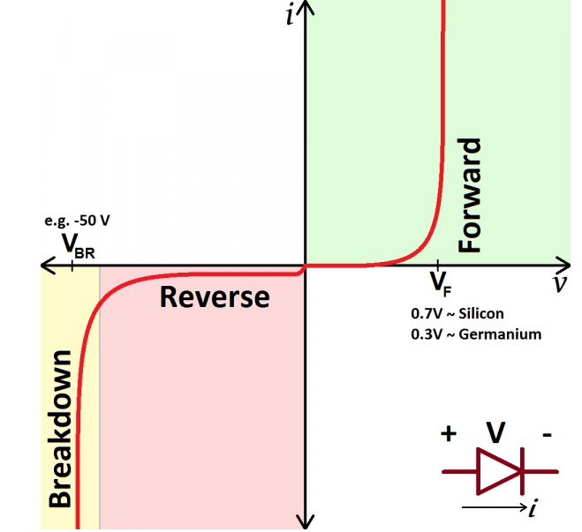
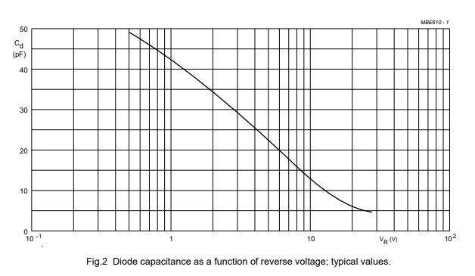
Background
Diode Non-linear
V-I curve taken
from Sparkfun
What is a capacitor?
A linear device which store charge
What is a varactor-diode?
A diode which can act as a non-linear voltage-dependent capacitor
Graph of Voltage-dependent capacitance from
BBY40 Varactor (Varicap) Diode Datasheet.

Slide 4
Background Continued
What are Non-Linear Transmission Lines (NLTL’s)
NLTL’s take into account that a wire is not just a wire. It is modeled with parasitics and is loaded by non-linear devices like varactors.
Why might modeling/simulating this be useful?
It allows us to predict how well these devices work for a given purpose (see next slide)

Slide 5
Where do we fit into this picture?
Rohde and Schwarz is a company specializing in the production of measurement equipment (Oscilloscopes, VNA’s, etc..)
To measure very fast signals (>Ghz), we need to sample them with waves at least twice as fast (according to NyQuist theory)
NLTL’s can be observed to have “pulse sharpening effects” which take in a square wave with a defined “rise time” and reduce the time it takes to reach its pulsed value.
In theory, this allows us to use very fast waves without worry of the pulses overlapping or “aliasing”

Slide 6
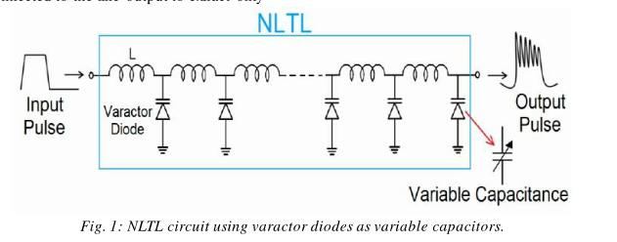
Pulse sharpening
Main considerations
How much power do we lose due to
parasitics
How much can we sharpen a given
pulse before the costs outweigh the benefits
Image taken from: International Journal of Advanced Engineering Research and Science. [Vol-5, Issue-10, Oct-2018]

Slide 7
Progress (Background)
Worked through a lot of background research through IEEE articles relating to
Diode/component modeling (SPICE, ADS, Verilog-A Modules)
Designs utilizing nonlinear components
Proper calibration of test equipment (S-Parameter De-embedding techniques)
SOLT
2x Thru
NTLT Theory
Applications: pulse sharpening, phase shifting
PCB Design for microwave signals

Slide 8
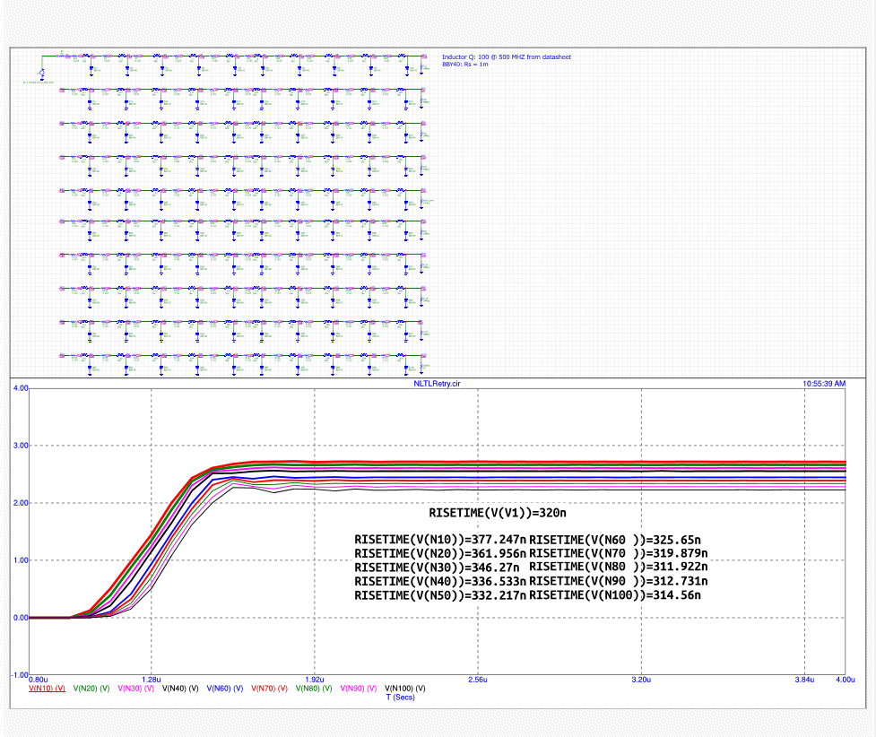
Progress (Simulations)
Less than a week away from completing
Analysis of time-domain behaviour
Specifically…
Rise time vs. bias voltage
Rise time vs. length of line
Power Delivery vs. bias voltage
Power delivery vs. line length
Figure: Rise Time vs # of sections on a 100-ladder long NLTL

Slide 9
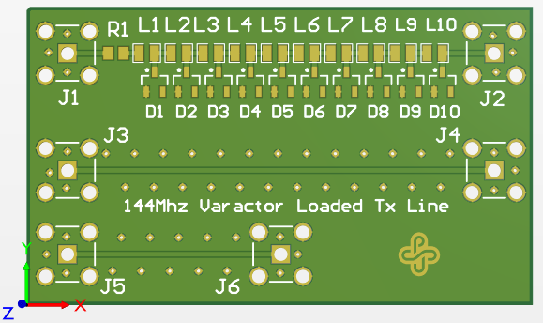
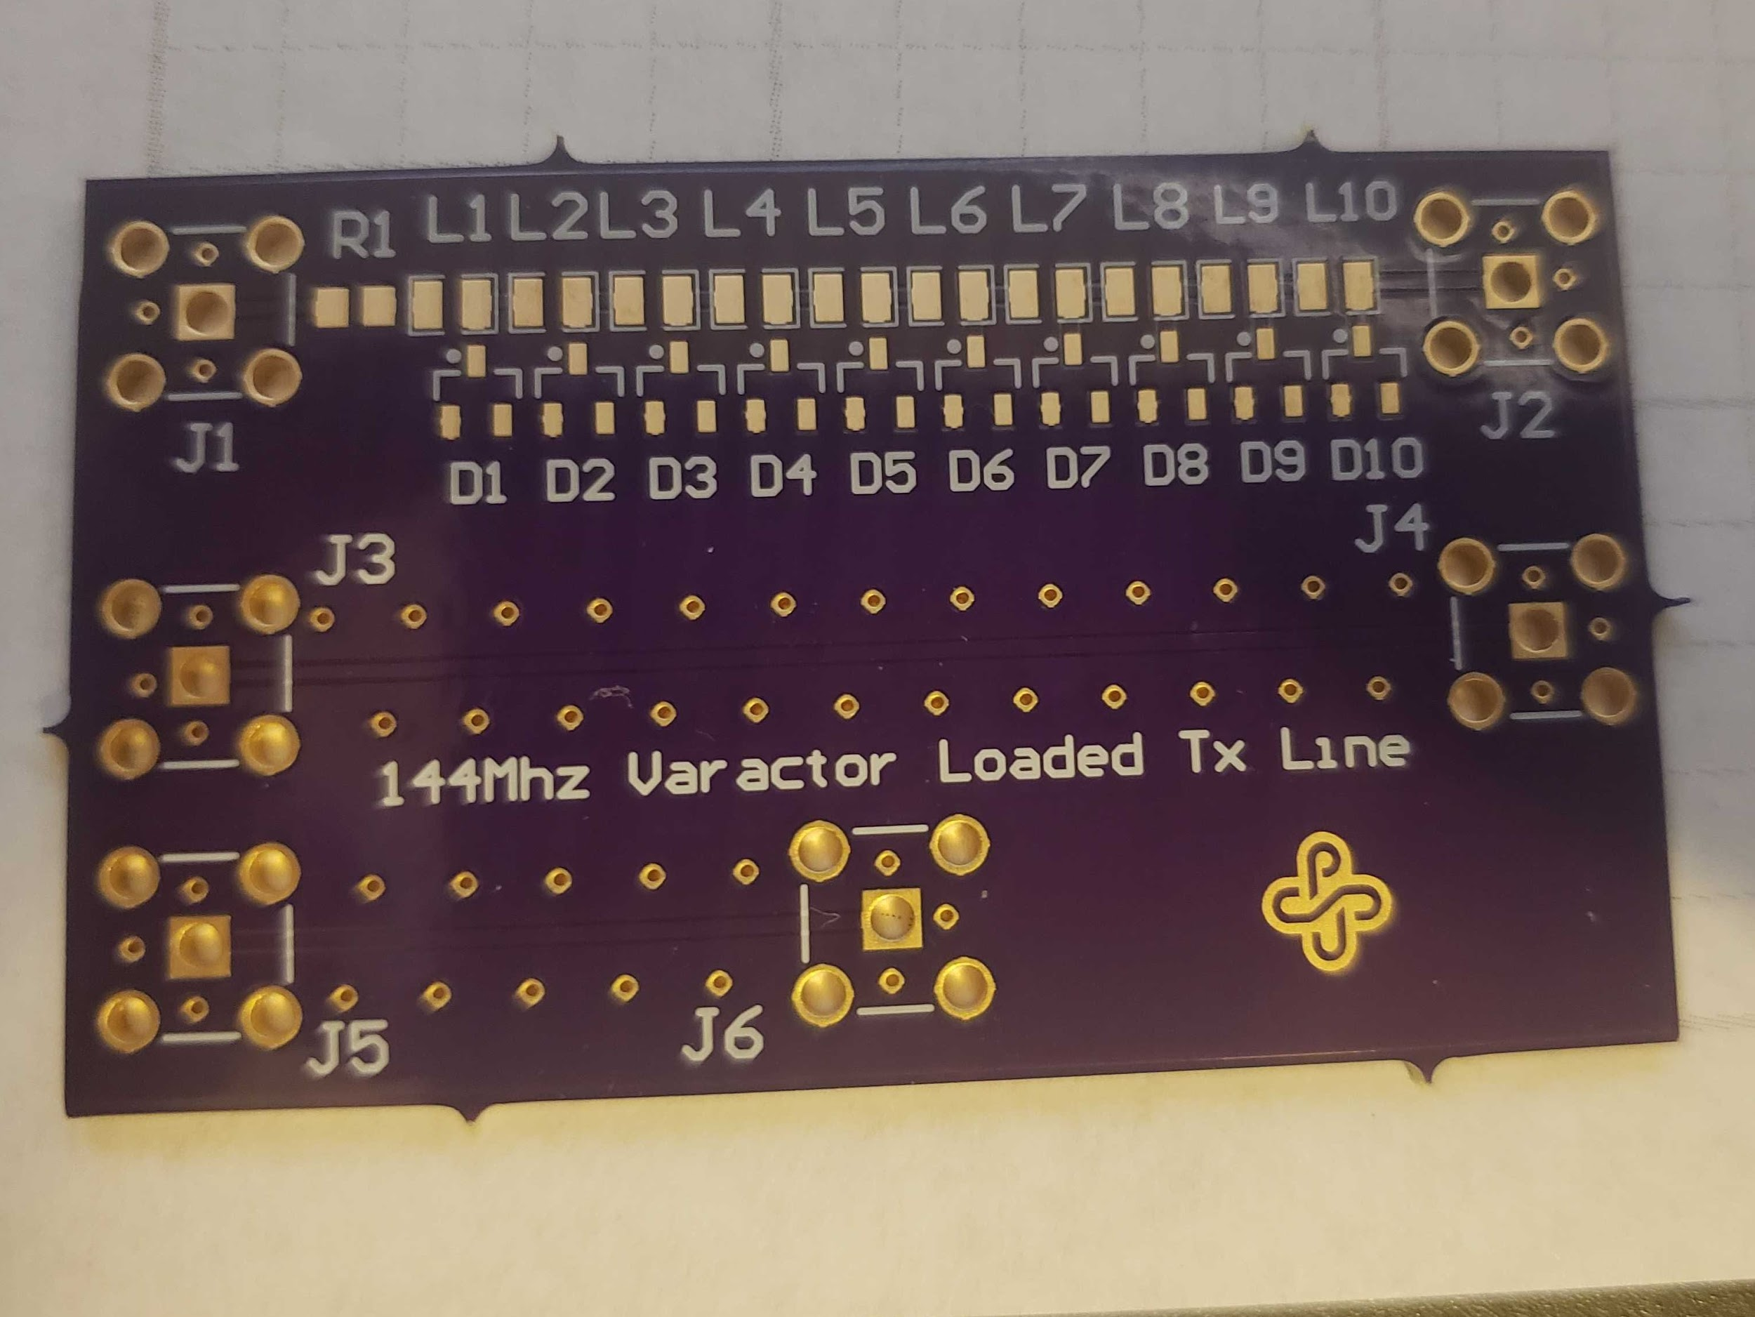
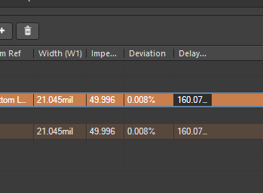
Progress (Hardware)
First prototype (144Mhz) designed in Altium
Board Received from OSHPark (Qty. 3)
Less than a week away from completing
Time domain measurements (Using scope)
Frequency domain measurements (Using nanoVna)
Altium 3D Rendered Board (Top)
and
Impedance Calculator Results (Bottom)
Received Board from OSHPark

Slide 10
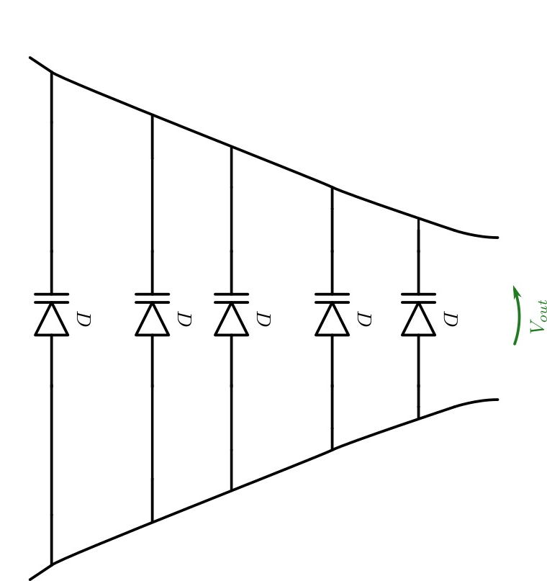
Where do we go from here?
Measurements
Modeling Varactor as a Verilog-A Module
Experimenting with differing board geometries
Wave breaking on a beach analogy
EM Simulations of board using Momentum
Complete documentation of process (White Paper Format)
We have discussed with our Sponsor re-scoping of project deliverables and refocus on proper documentation and drafting of Design Guide.
Figure: Example of possible experiments with circuit geometry

Slide 11
Conclusion
Because of the situation we have to change the scope of the project, we have discussed this with the industry sponsor.
Things left to do/currently being work on:
6GHz prototype
Measurements
Documentation
Poster

Slide 12
Questions?

